Slide 1
Team Number: 15 – Blockchain Application
Batch: 2022 2YB
Members:
V Som Sekhar (82)
Aarnav Pant (67)
Pranav Kulkarni (46)

Slide 2
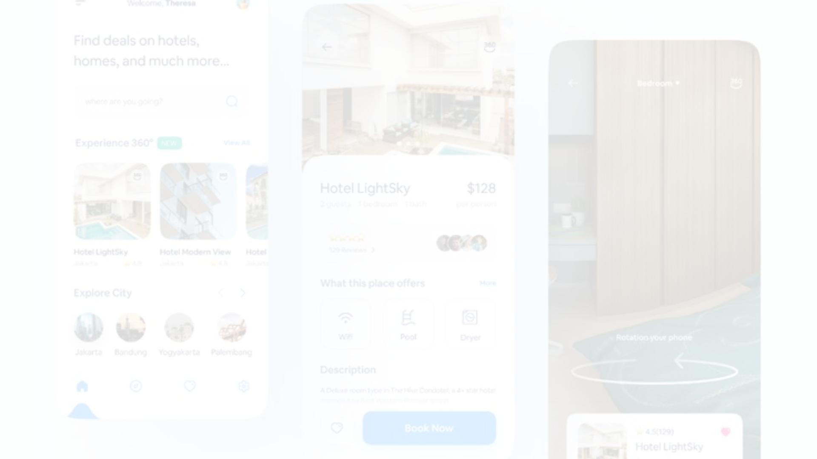
Project Overview
1
Login and Register
2
List of Cryptos
Users can securely log in and register for the application.
List of Cryptos and their real time details

Slide 3
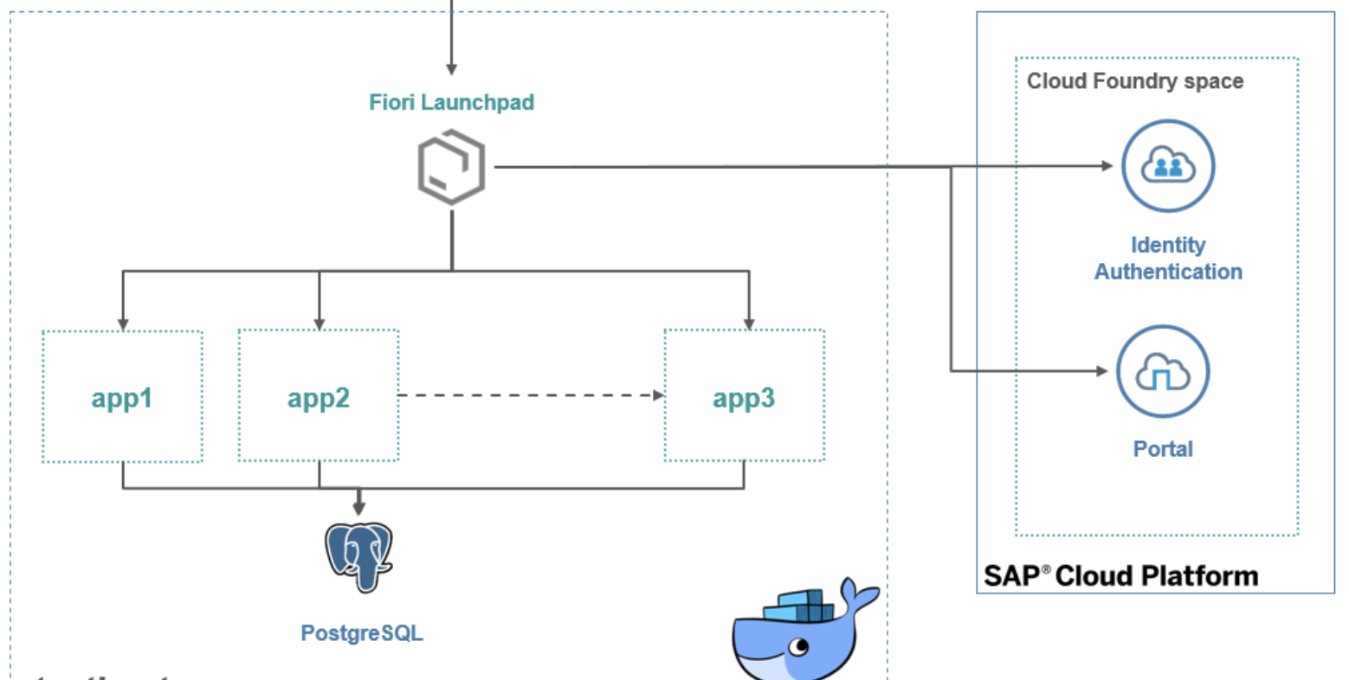
Architecture & Design
We deployed our backend in Cloud Foundry and using PostgreSQL service for DB

Slide 4
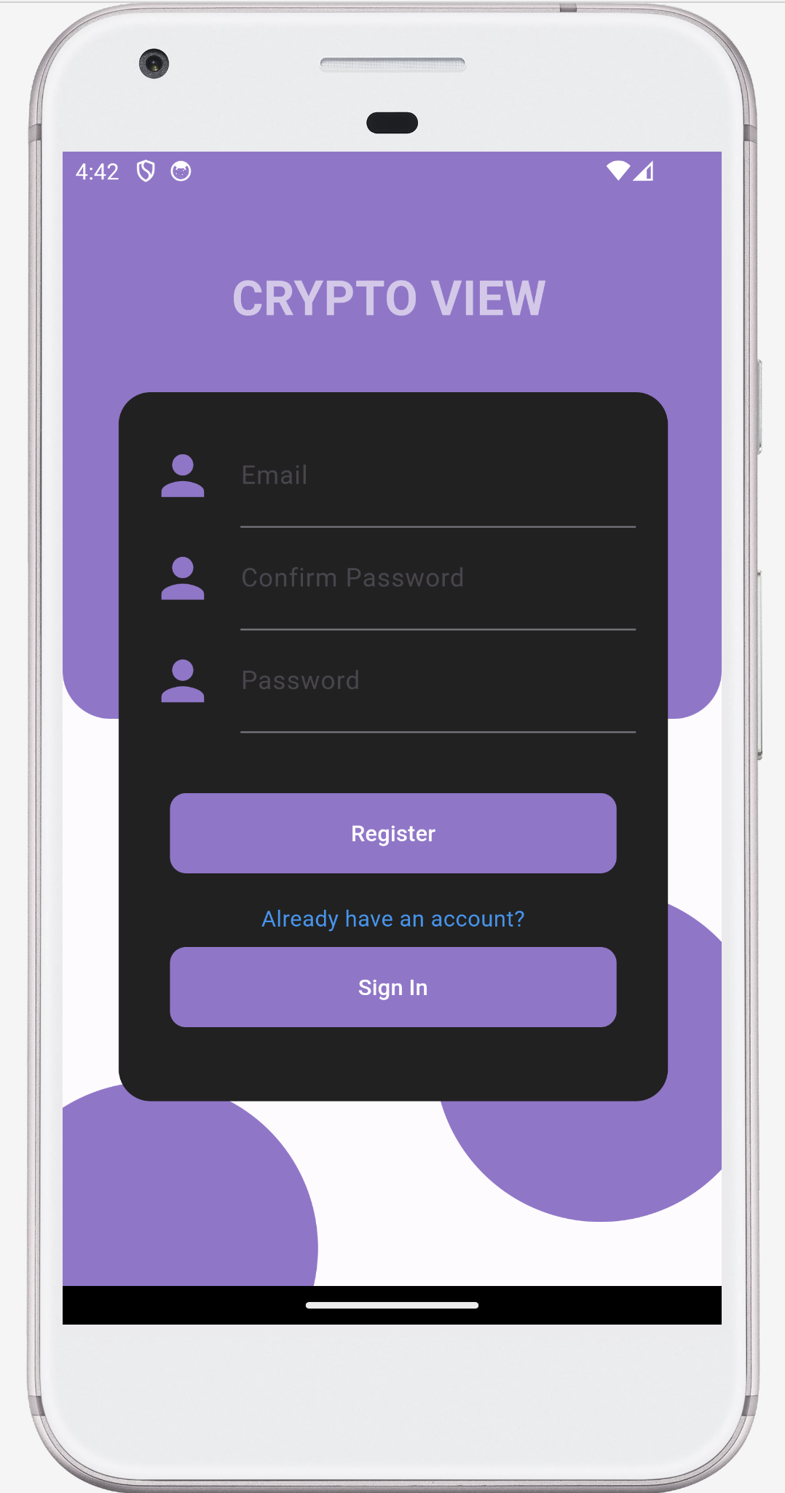
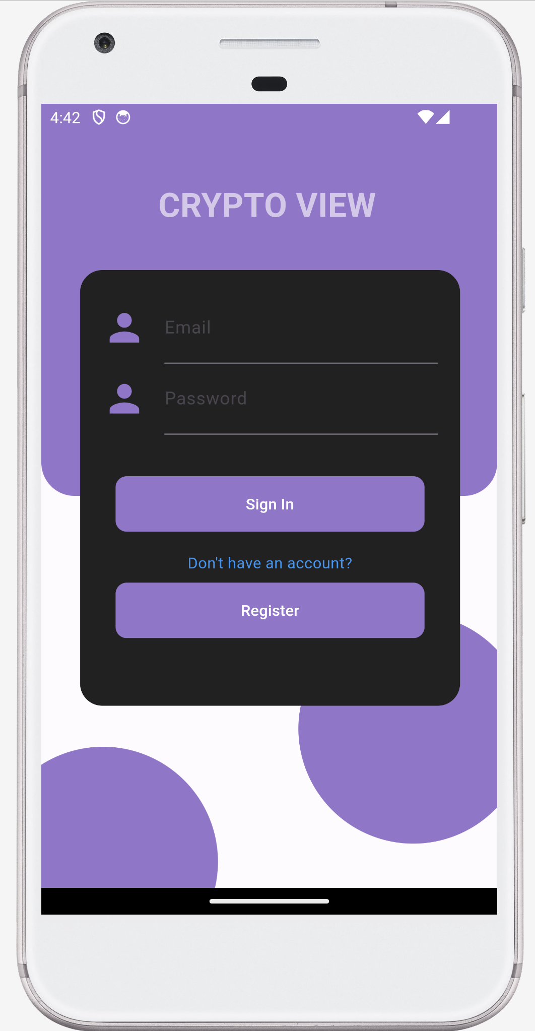

Slide 5
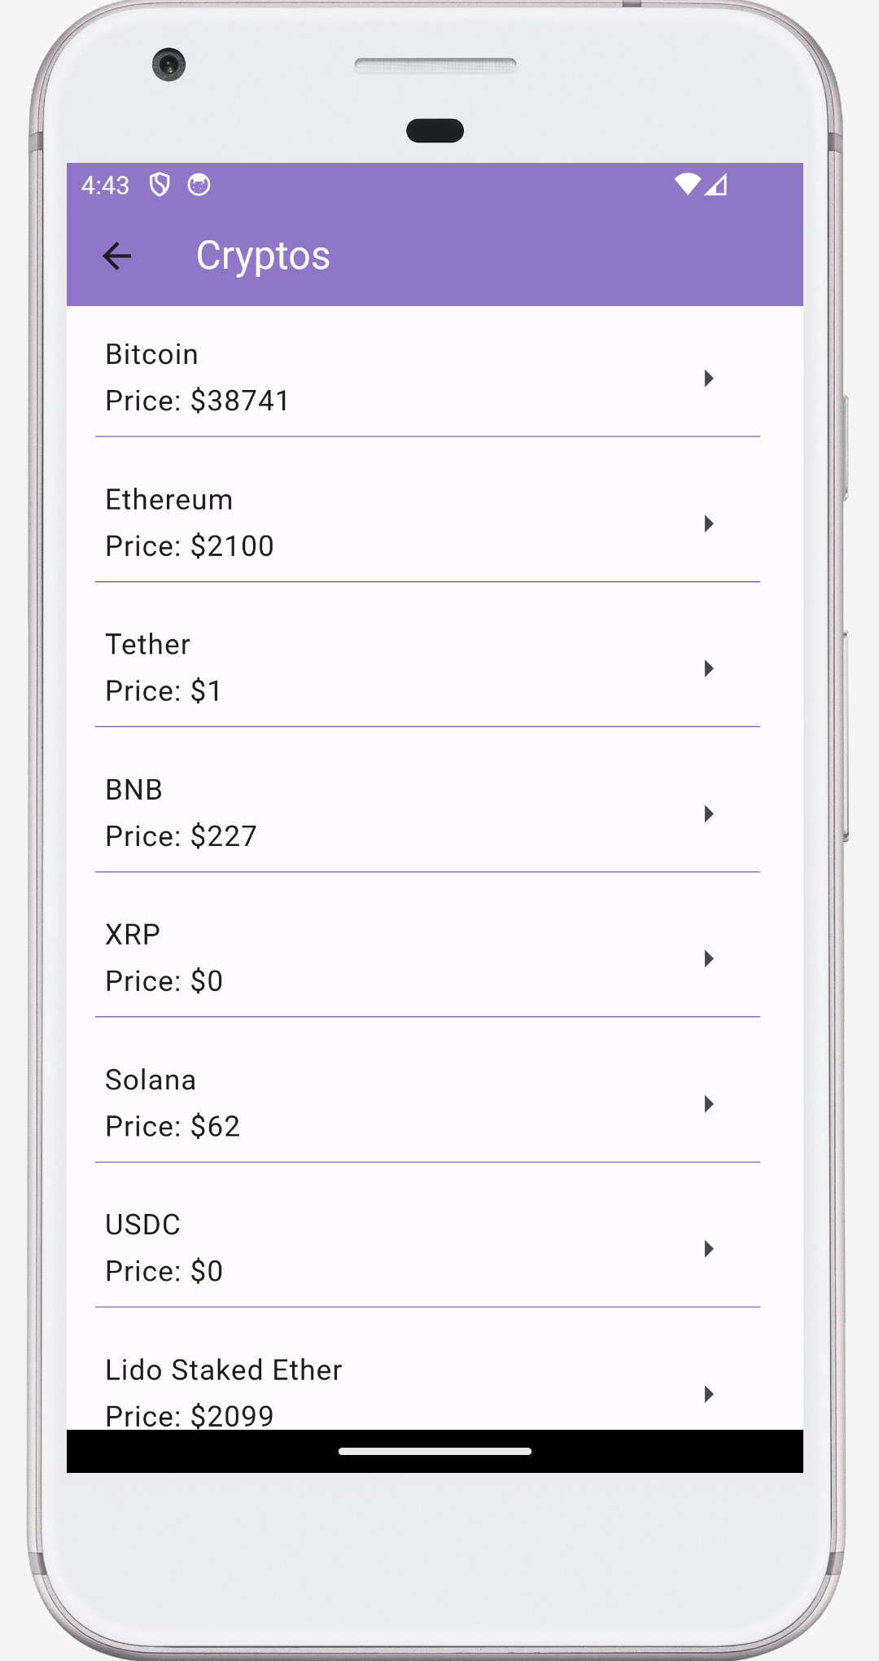
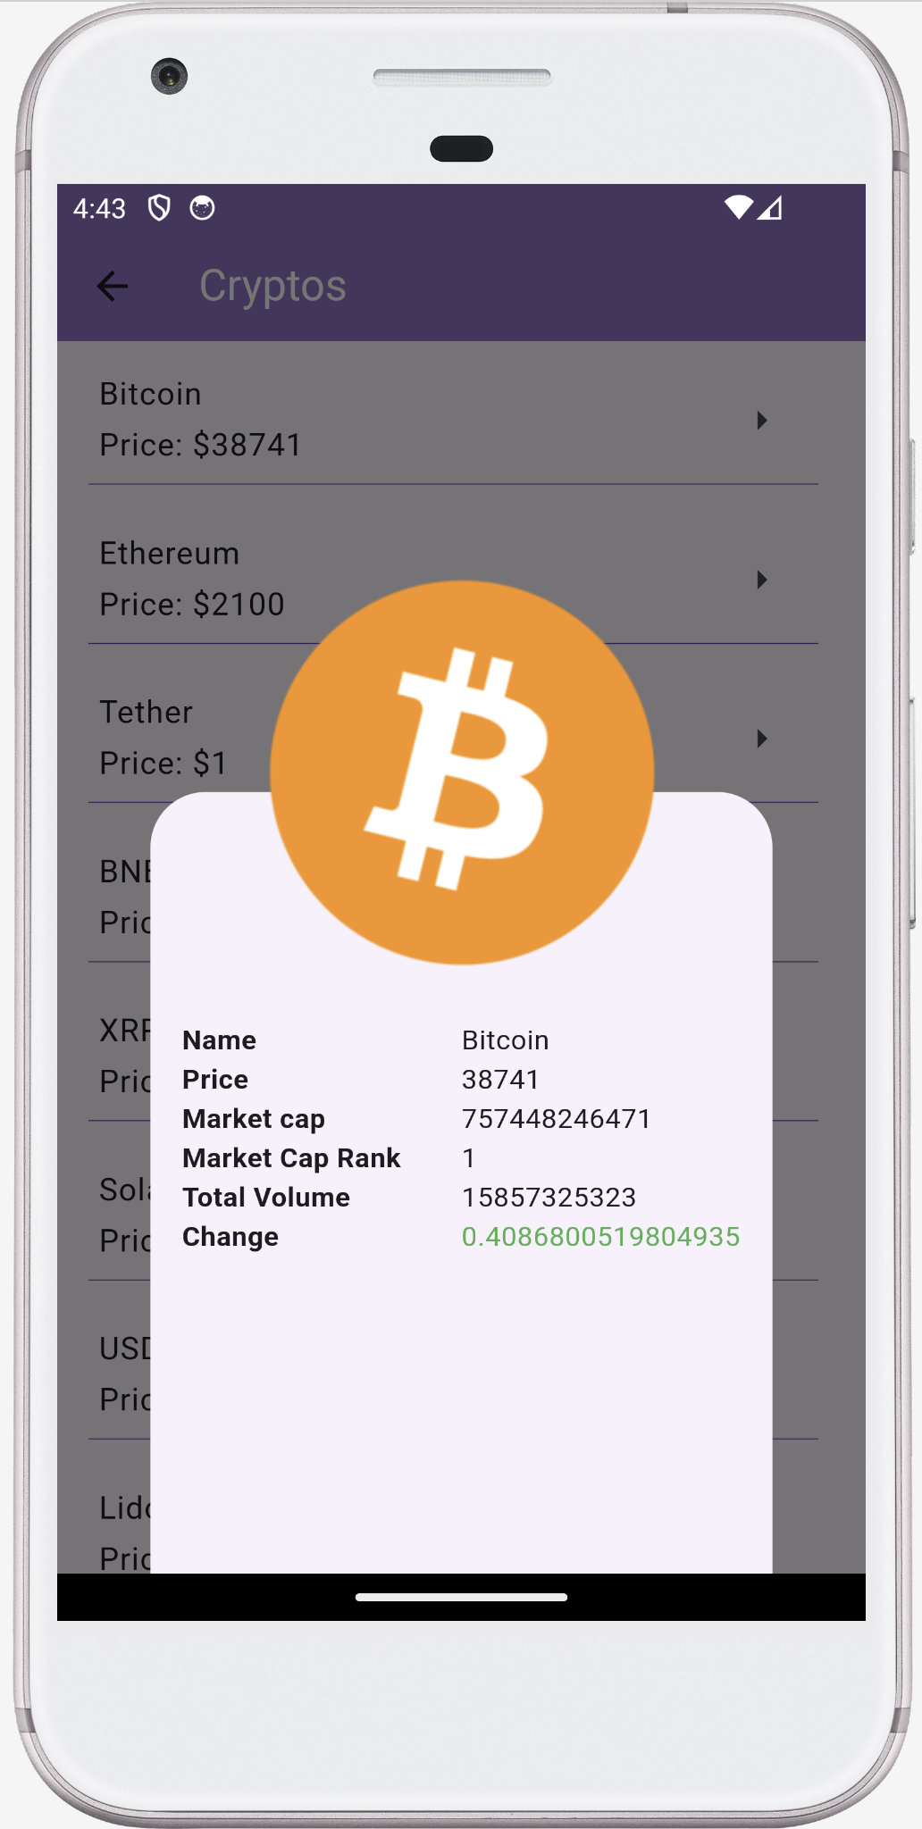

Slide 6


Challenges & Learnings
Flutter Learning
Mac Setup
Overcoming the challenge of learning flutter within a short time frame.
Navigating the setup process on Mac for the development environment.

Slide 7

Project Highlights
Interactive Features
Deliver a user-centric experience through interactive elements and intuitive design.
Efficient Data Management
Ensure efficient data storage and retrieval using Firestore.
Seamless User Experience
Focus on providing a seamless and hassle-free experience for users.

Slide 8
Thank You

